Slide 1


Slide 2
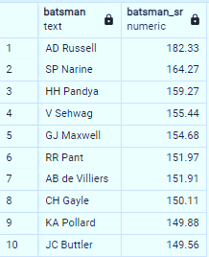
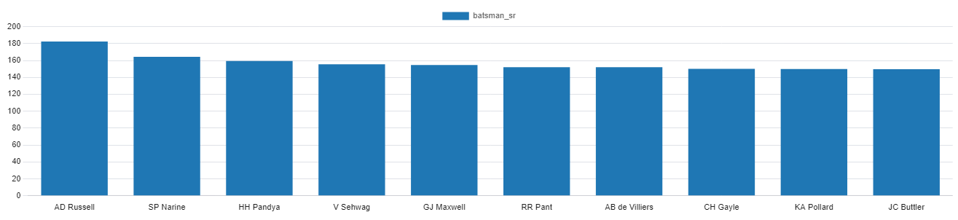
List of 10 batsman with high batting strike rate who have faced at least 500 balls
SELECT
batsman,
ROUND((SUM(batsman_runs)*1.0 / COUNT(ball)) * 100,2) AS batsman_sr
FROM ipl_ball
WHERE
extra_type not in ('wides')
GROUP BY
batsman
HAVING
COUNT(ball) > 500
ORDER BY
batsman_sr DESC
LIMIT 10;

Slide 3
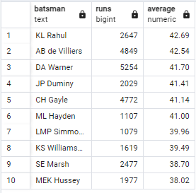
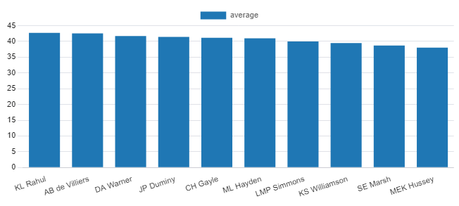
List of 10 players with best average who have played more than 2 IPL seasons (or 28 matches)
SELECT
batsman,
SUM(batsman_runs) AS runs,
ROUND(SUM(batsman_runs)*1.0/SUM(is_wicket),2) AS average
FROM ipl_ball
GROUP BY
batsman
HAVING
SUM(is_wicket) > 0 AND COUNT(DISTINCT id) > 28
ORDER BY
average DESC
LIMIT 10;

Slide 4
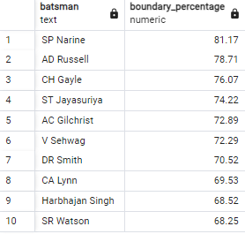
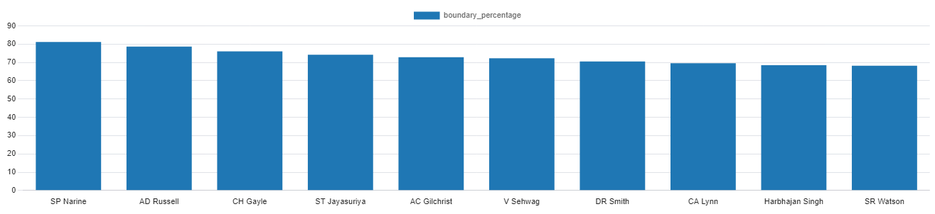
List of 10 players who have scored most runs in boundaries and have played more than 2 IPL seasons(more than 28 matches).
SELECT
batsman,
ROUND(SUM(CASE WHEN batsman_runs in(4,6) THEN batsman_runs else 0 END)*1.0 / SUM(batsman_runs)*100,2) AS boundary_percentage
FROM ipl_ball
WHERE
extra_type NOT IN ('wides')
GROUP BY
batsman
HAVING
COUNT(DISTINCT id) > 28
ORDER BY
boundary_percentage DESC
LIMIT 10;

Slide 5
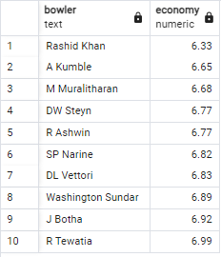
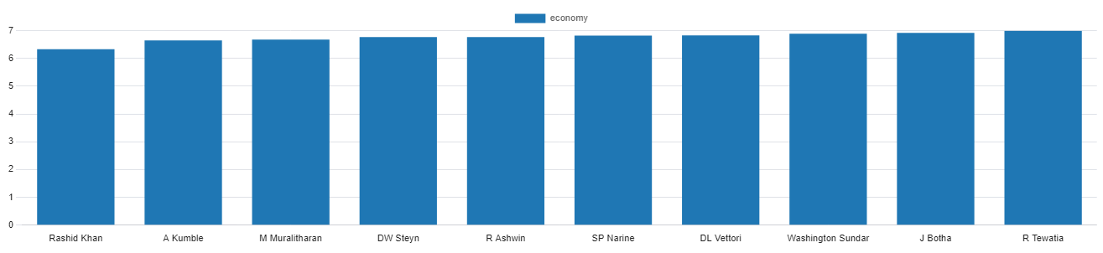
List of 10 bowlers with best economy who have bowled at least 500 balls in IPL
SELECT
bowler,
ROUND(SUM(total_runs)/(COUNT(bowler)/6.0), 2)
as economy
FROM ipl_ball
GROUP BY
bowler
HAVING
COUNT(bowler) > 500
ORDER BY
economy
LIMIT 10;

Slide 6
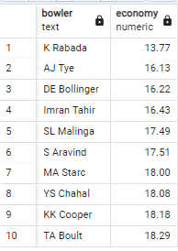
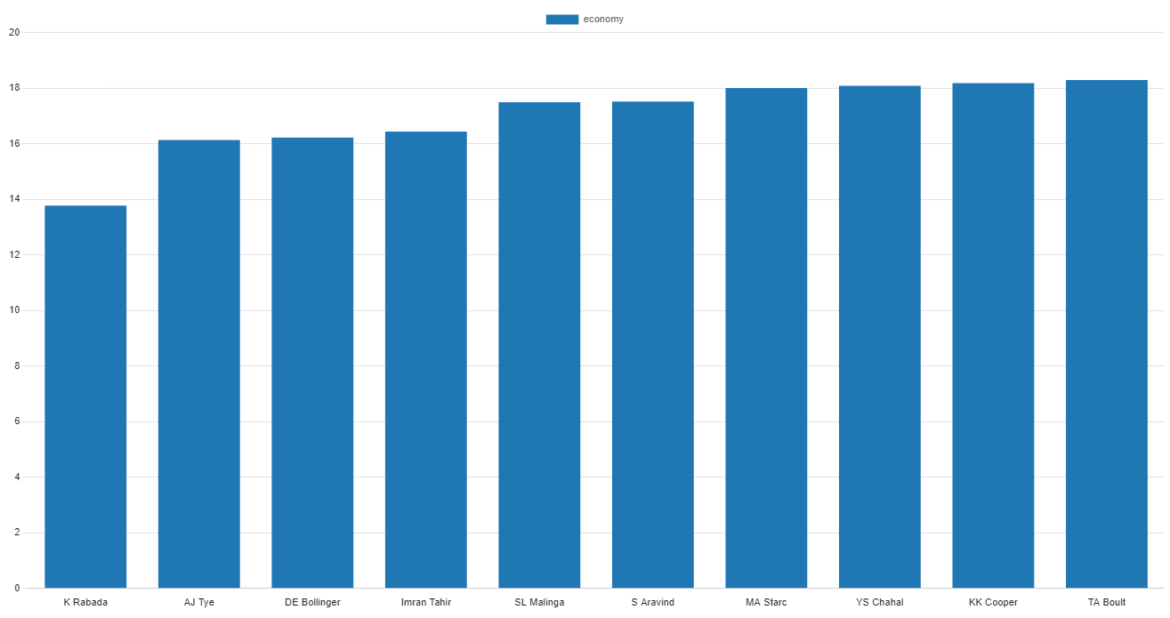
List of 10 bowlers who have the best strike rate and who gave bowled at least 500 balls
WITH ValidDismissals AS (
SELECT
bowler,
is_wicket,
CASE
WHEN dismissal_kind IN ('bowled', 'caught', 'caught and bowled', 'hit wicket', 'lbw', 'stumped')
THEN 1
ELSE 0
END AS is_valid_dismissal
FROM ipl_ball
)
SELECT
bowler,
ROUND(COUNT(bowler) * 1.0 / SUM(is_valid_dismissal),2) AS economy
FROM
ValidDismissals
GROUP BY
bowler
HAVING
COUNT(bowler) > 500
ORDER BY
economy
LIMIT 10;

Slide 7
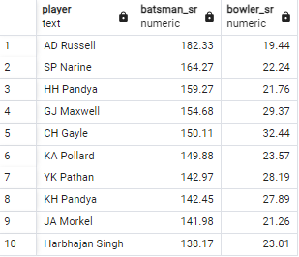
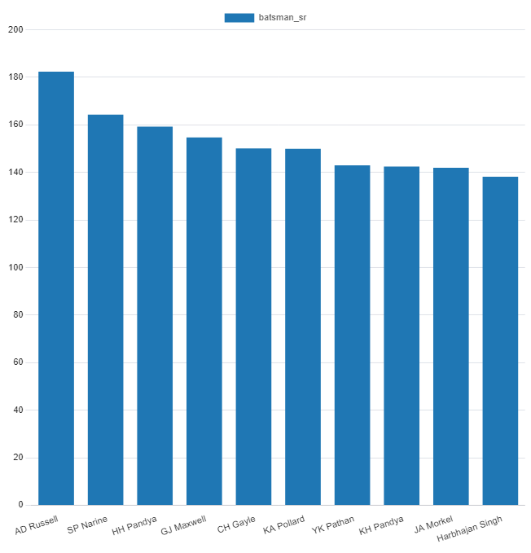
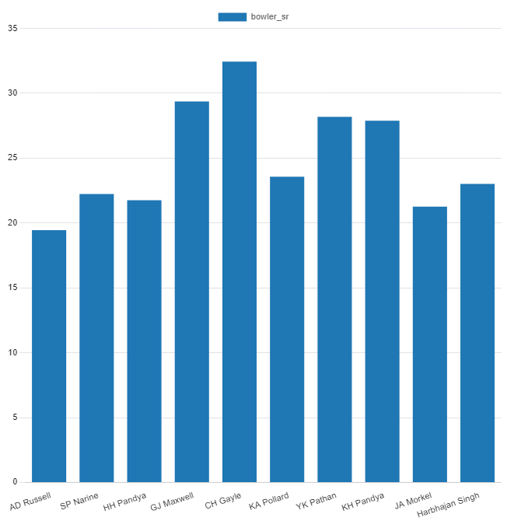
List of 10 allrounders who have the best bowling and batting strike rate and who gave faced at least 500 balls and bowled at least 300 balls.
SELECT
b.batsman AS player,
b.batsman_sr,
e.bowler_sr
FROM batsman_strike_rate b
JOIN
bowlers_strike_rate e ON b.batsman = e.bowler
ORDER BY
b.batsman_sr DESC,
e.bowler_sr ASC
LIMIT 10;

Slide 8
The most important criteria for selecting WICKETKEEPERS in the IPL.
Batting Ability: Prioritize wicketkeepers who can score quickly and hit boundaries, contributing to the team's run total.
Agility and Glovework: Strong wicketkeeping skills are vital. Look for wicketkeepers with quick reflexes, clean catching ability, and accurate stumpings.
Experience: Consider wicketkeepers with T20 experience who can handle pressure situations effectively.
Versatility: Choose wicketkeepers who can adapt to different match scenarios and contribute effectively in various batting positions.
Leadership and Communication: Wicketkeepers who can lead the fielding unit and effectively communicate with bowlers and fielders are valuable.
Fielding: Prioritize wicketkeepers with excellent fielding skills, capable of creating run-out opportunities.
Consistency: Look for wicketkeepers with a consistent track record, both in batting and wicketkeeping, to ensure stable performance throughout the tournament.

Slide 9
Additional Questions

Slide 10
1. Get the count of cities that have hosted an IPL match.
CITY_COUNTS
33

Slide 11
2. Create table deliveries_v02 with all the columns of the table ‘deliveries’ and an additional column ball_result containing values boundary, dot or other depending on the total_run (boundary for >= 4, dot for 0 and other for any other number)
CREATE TABLE deliveries_v02 AS
SELECT
*,
CASE
WHEN total_runs >= 4 THEN 'boundary'
WHEN total_runs = 0 THEN 'dot'
ELSE 'other'
END AS ball_result
FROM ipl_ball;

Slide 12
3. Write a query to fetch the total number of boundaries and dot balls from the deliveries_v02 table.
SELECT
ball_result,
COUNT(*) AS total_count
FROM
deliveries_v02
WHERE
ball_result IN ('boundary', 'dot')
GROUP BY
ball_result;
Counts
Boundary | 31468
Dot | 67841

Slide 13
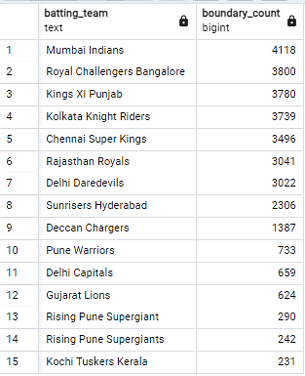
4. Write a query to fetch the total number of boundaries scored by each team from the deliveries_v02 table and order it in descending order of the number of boundaries scored.
SELECT
batting_team,
COUNT(*) AS boundary_count
FROM
deliveries_v02
WHERE
ball_result = 'boundary'
GROUP BY
batting_team
ORDER BY
boundary_count DESC;

Slide 14
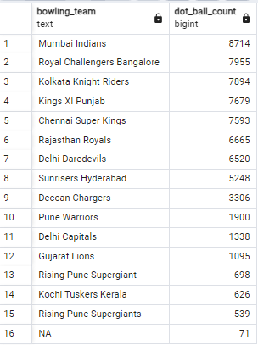
5. Write a query to fetch the total number of dot balls bowled by each team and order it in descending order of the total number of dot balls bowled.
SELECT
bowling_team,
COUNT(*) AS dot_ball_count
FROM
deliveries_v02
WHERE
ball_result = 'dot'
GROUP BY
bowling_team
ORDER BY
dot_ball_count DESC;

Slide 15
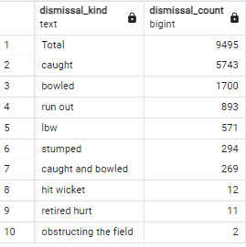
6. Write a query to fetch the total number of dismissals by dismissal kinds where dismissal kind is not NA
SELECT
COALESCE(dismissal_kind, 'Total') AS dismissal_kind,
COUNT(*) AS dismissal_count
FROM
deliveries_v02
WHERE
dismissal_kind IS NOT NULL
AND dismissal_kind != 'NA'
GROUP BY
ROLLUP(dismissal_kind)
ORDER BY
dismissal_count DESC;

Slide 16
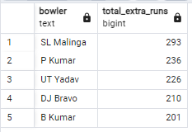
7. Write a query to get the top 5 bowlers who conceded maximum extra runs from the deliveries table
SELECT
bowler,
SUM(extra_runs) AS total_extra_runs
FROM
deliveries_02
GROUP BY
bowler
ORDER BY
total_extra_runs DESC
LIMIT 5;

Slide 17
8. Write a query to create a table named deliveries_v03 with all the columns of deliveries_v02 table and two additional column (named venue and match_date) of venue and date from table matches
CREATE TABLE deliveries_v03 AS
SELECT
d.*,
m.venue,
m.date as match_date
FROM
deliveries_v02 d
JOIN
matches m
ON
d.id = m.id;

Slide 18
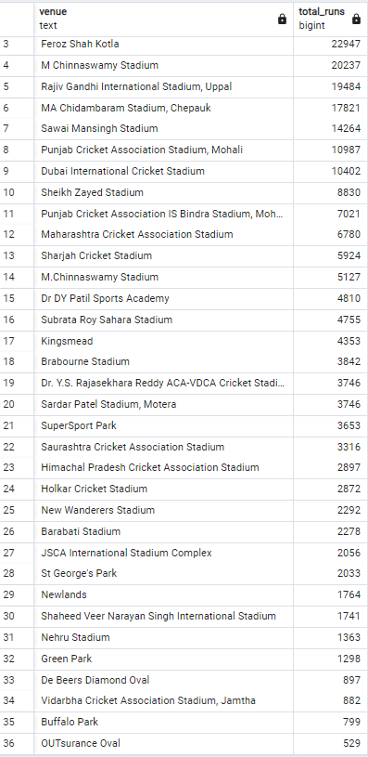
9. Write a query to fetch the total runs scored for each venue and order it in the descending order of total runs scored.
SELECT
m.venue,
SUM(d.total_runs) AS total_runs
FROM
ipl_matches m
JOIN
ipl_ball d
ON
m.id = d.
GROUP BY
m.venue
ORDER BY
total_runs DESC;

Slide 19
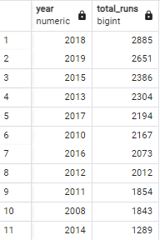
10. Write a query to fetch the year-wise total runs scored at Eden Gardens and order it in the descending order of total runs scored.
SELECT
EXTRACT(YEAR FROM m.date) AS year,
SUM(d.total_runs) AS total_runs
FROM
ipl_matches m
JOIN
ipl_ball d
ON
m.id = d.id
WHERE
m.venue = 'Eden Gardens'
GROUP BY
year
ORDER BY
total_runs DESC;

Slide 20


